Slide 1

False Position Method
Prianka Mandal
Lecturer
Daffodil International University

Slide 2
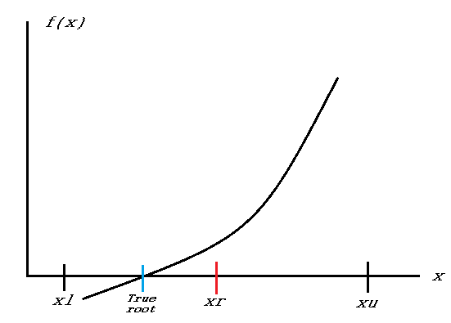
How Bisection Works?
Figure-1

Slide 3
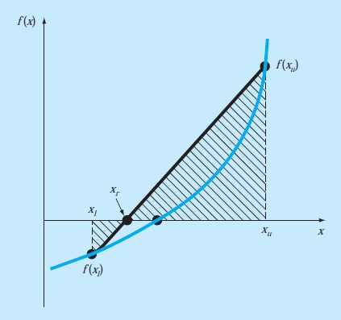
How False Position Works?
Figure-2

Slide 4
False Position Method
A shortcoming of the bisection method is that, in dividing the interval from x_{l} to x_{u} into equal halves, no account is taken of the magnitudes of f (x_{l}) and f (x_{u}).
For example, if f (x_{l}) is much closer to zero than f (x_{u}), it is likely that the root is closer to x_{l} than to x_{u} (Figure-2)
An alternative method that exploits this graphical insight is to join f(x_{l}) and f (x_{u}) by a straight line.

Slide 5
False Position Method (cont..)
The intersection of this line with the x axis represents an improved estimate of the root.
The fact that the replacement of the curve by a straight line gives a “false position” of the root is the origin of the name, method of false position, or in Latin, regula falsi.
It is also called the linear interpolation method.

Slide 6


False Position Method (cont..)
Using similar triangles (Fig. 2), the intersection of the straight line with the x axis can be estimated as,
which can be solved for (see Box 5.1 for details):
The steps of False Position Method is similar to Bisection Method except the root calculation equation.

Slide 7
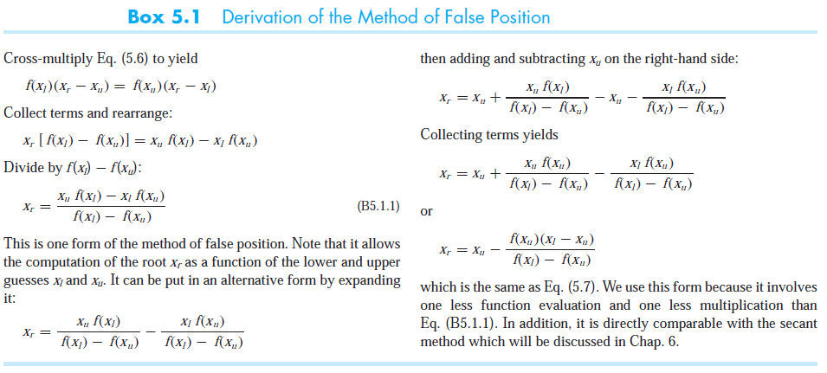
Derivation of the Method of False Position

Slide 8
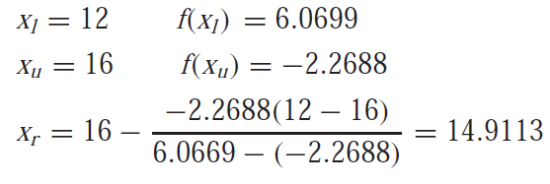
An Example
Use the false-position method to determine the root of the same equation investigated in the Bisection Method in previous slide.
Solution:
Initiate the computation with guesses of xl = 12 and xu = 16.
First Iteration:
which has a true relative error, ε_{t} = 0.89 percent.

Slide 9

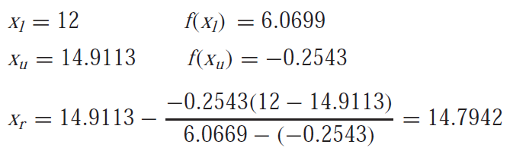
Second Iteration:
Therefore, the root lies in the first subinterval, and x_{r} becomes the upper limit for the next iteration, x_{u} = 14.9113:
which has true and approximate relative errors of 0.09 and 0.79 percent. Additional iterations can be performed to refine the estimate of the roots.

Slide 10
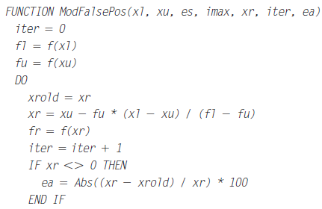
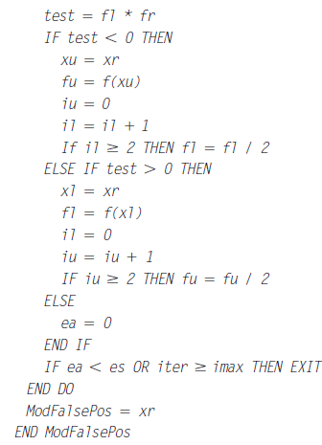
Pseudocode for Modified False Position

Slide 11
Lets do some exercise on Bracketing Methods
Determine the real root of f (x) = −26 + 85x − 91x² + 44x³ − 8x⁴ + x⁵ using bisection to determine the root to εs = 10%. Employ initial guesses of xl = 0.5 and xu = 1.0. Perform the same computation using the false position method and εs = 0.2 %.
Determine the roots of f (x) = −13 − 20x + 19x² − 3x³ using bisection, and false position. Use initial guesses of xl = −1 and xu = 0, and a stopping criterion of 1%.

Slide 12
Thank you!!!

